Slide 1
Photography Portfolio
By:Kendall Lathrop

Slide 2
All About Kendall
I have many things about me that make me the person I am today. For instance, my family is the number one thing in my life. They are always there for me, so I am always going to be there for them. I would say the second number one thing in my life is God. Just trusting him to guide me into the right direction will always bring hopefulness. Next, traveling is something that I enjoy a lot. I also really enjoy doing different sports. I have done basketball, volleyball, golf, and competitive dance. Out of all of those, I would say that my favorites are golf and dance. Also, in my free time I like to read. My experience in photography has been good. I have learned a lot about all the different aspects of photography. Now I even know how to take better quality photos.

Slide 3
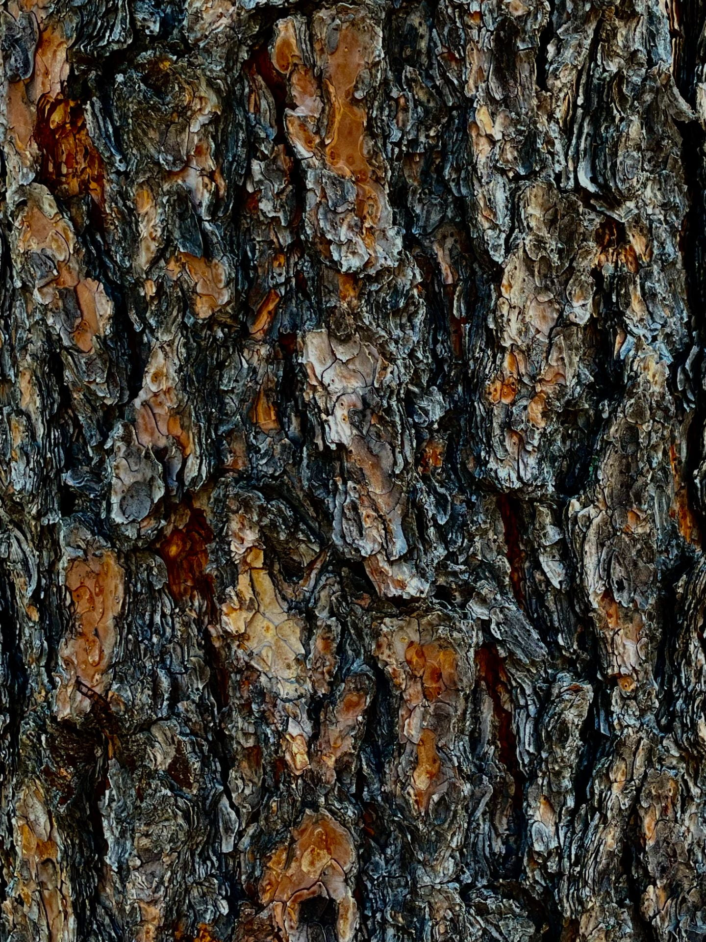
Texture
Vibrant Wood
The goal of the image was to get every crevice in the wood. To really show how the wood gives proper dimension. I think what made it unique was how the image was edited. I made the brown look more bright. I took the picture close up to show the composition of the photo. I didn’t want to take it far away, because I would not have been able to get each little detail.

Slide 4
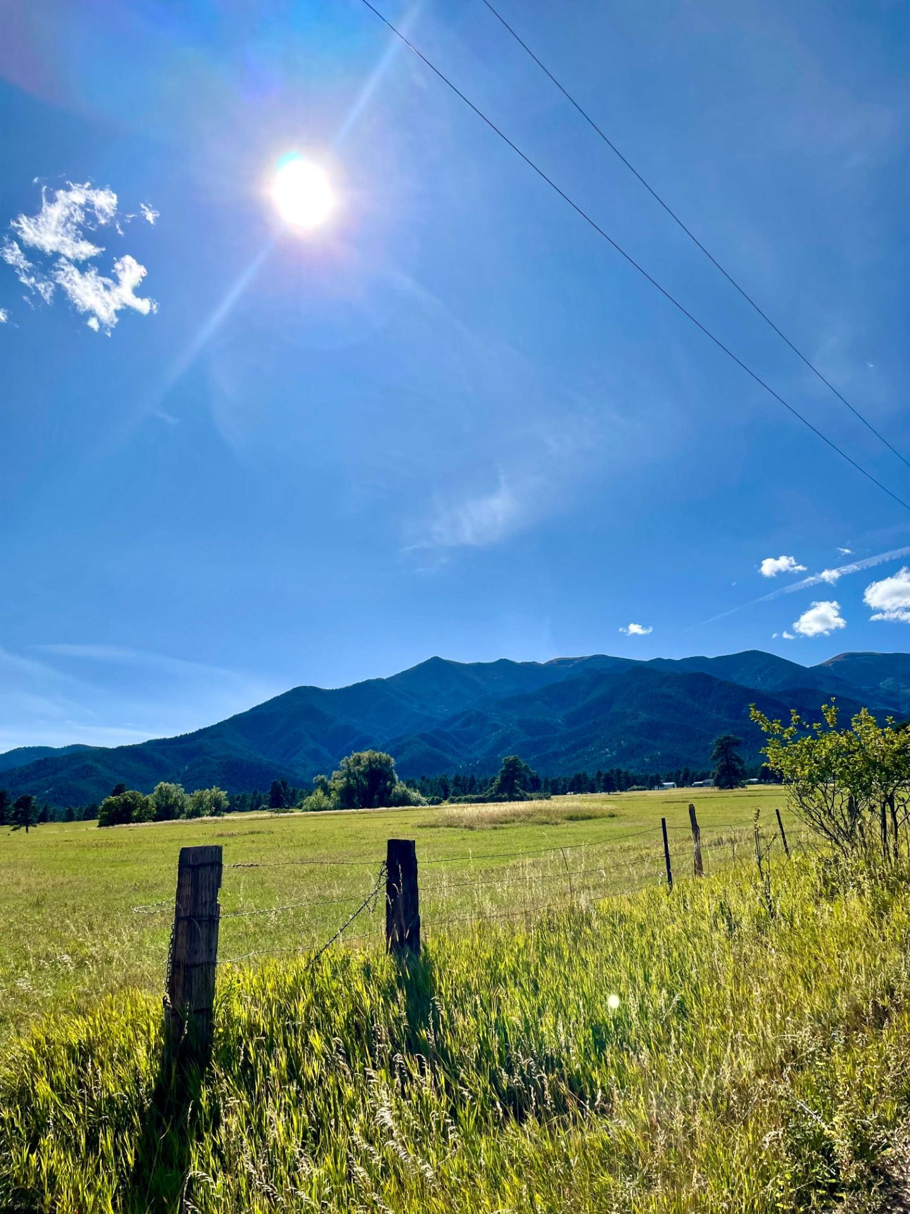
Grand Landscape Photo
Bright Sunny Day
The goal of the photo was to really capture the beautiful scenery. I look the photo far away to capture everything in the landscape. The picture is clear and not blurry. I edited it to make everything look more alive. For instance, the grass is more green. The mountains and sky have a brighter blue to them.

Slide 5
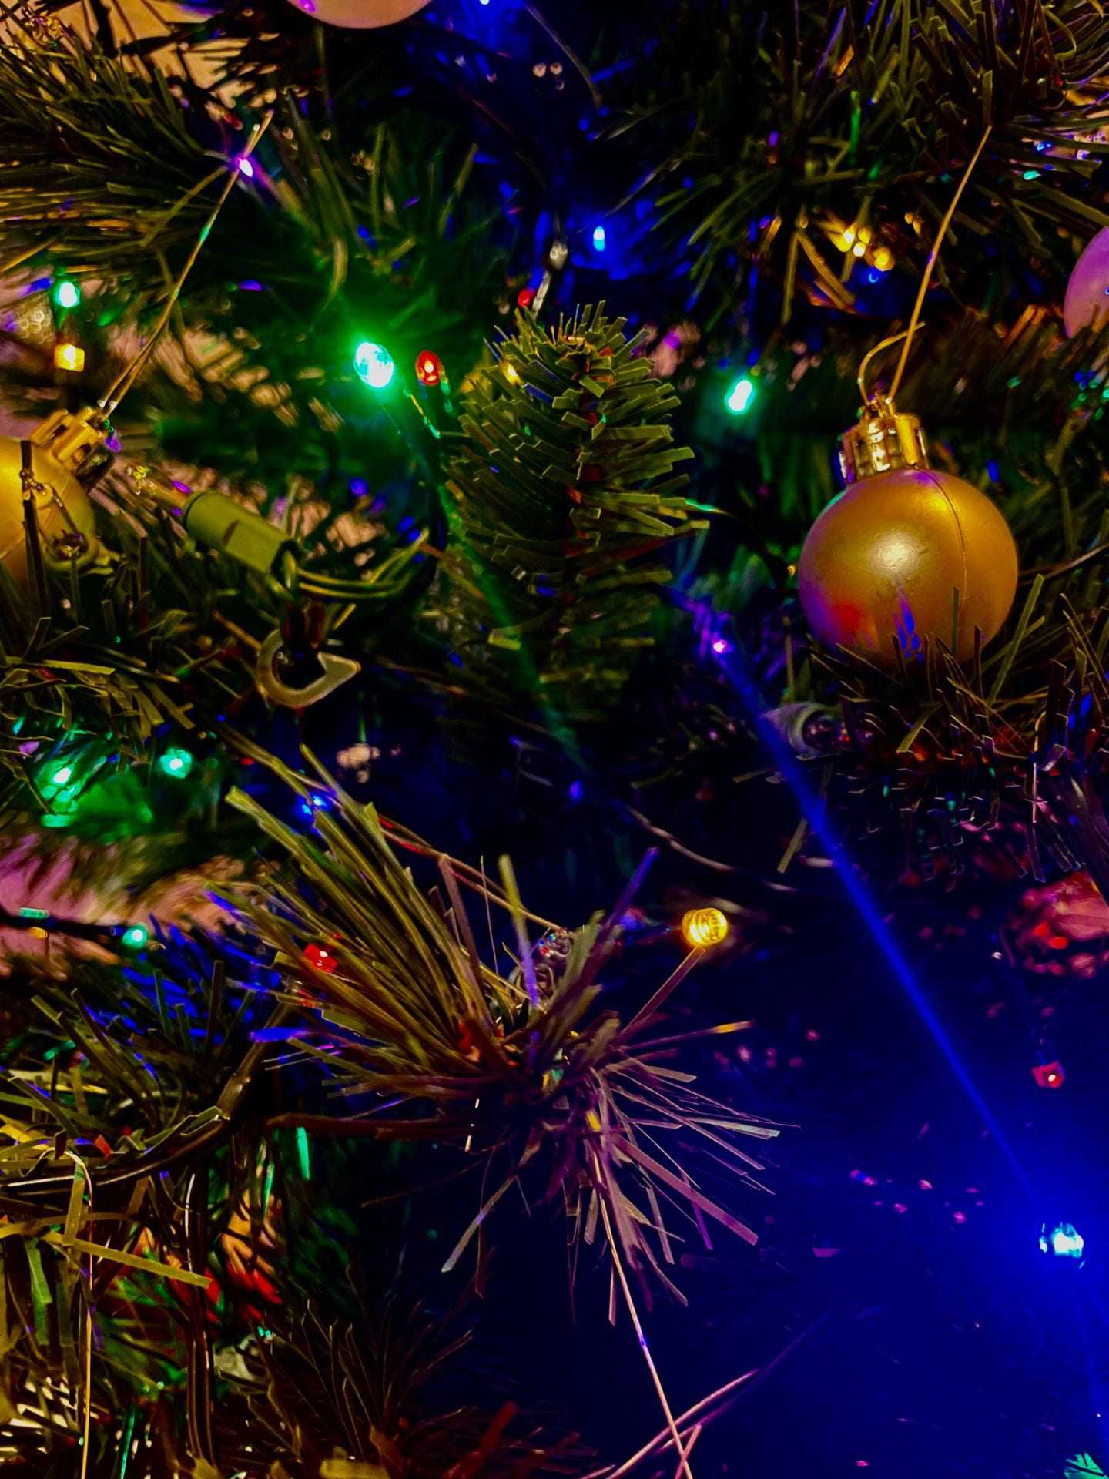
Macro Mode
Sparkly Tree
I took a close up picture to really show the goal of the picture. I tried to make everything seem bright and vibrant. I wanted it to look colorful. Also, tried making the ornaments seem shiny. The picture is clear. Although it has a unique characteristic of having the light shine through.

Slide 6
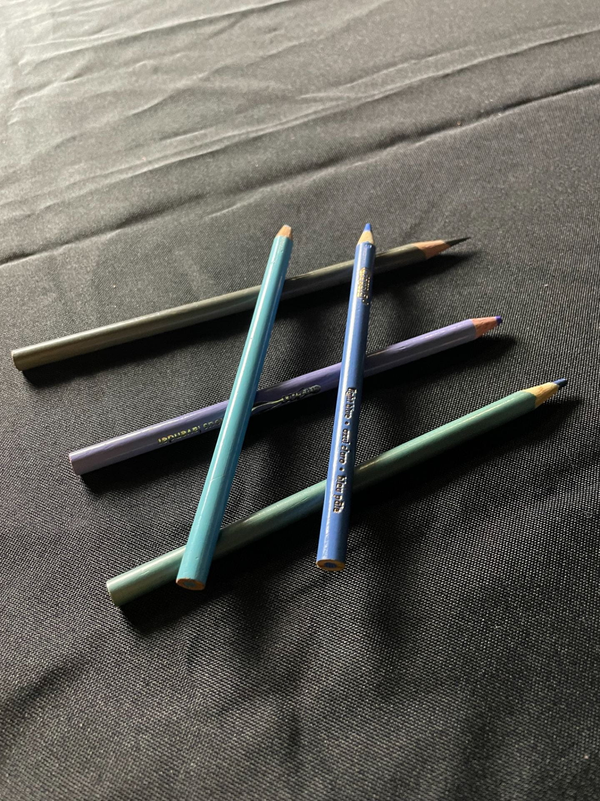
Still Life
Colorful Pencils
The goal was to make everyday objects look put together while still. I made the picture different by adding the two pencils on top and creating a design. I also took the picture far away to capture the design well.

Slide 7
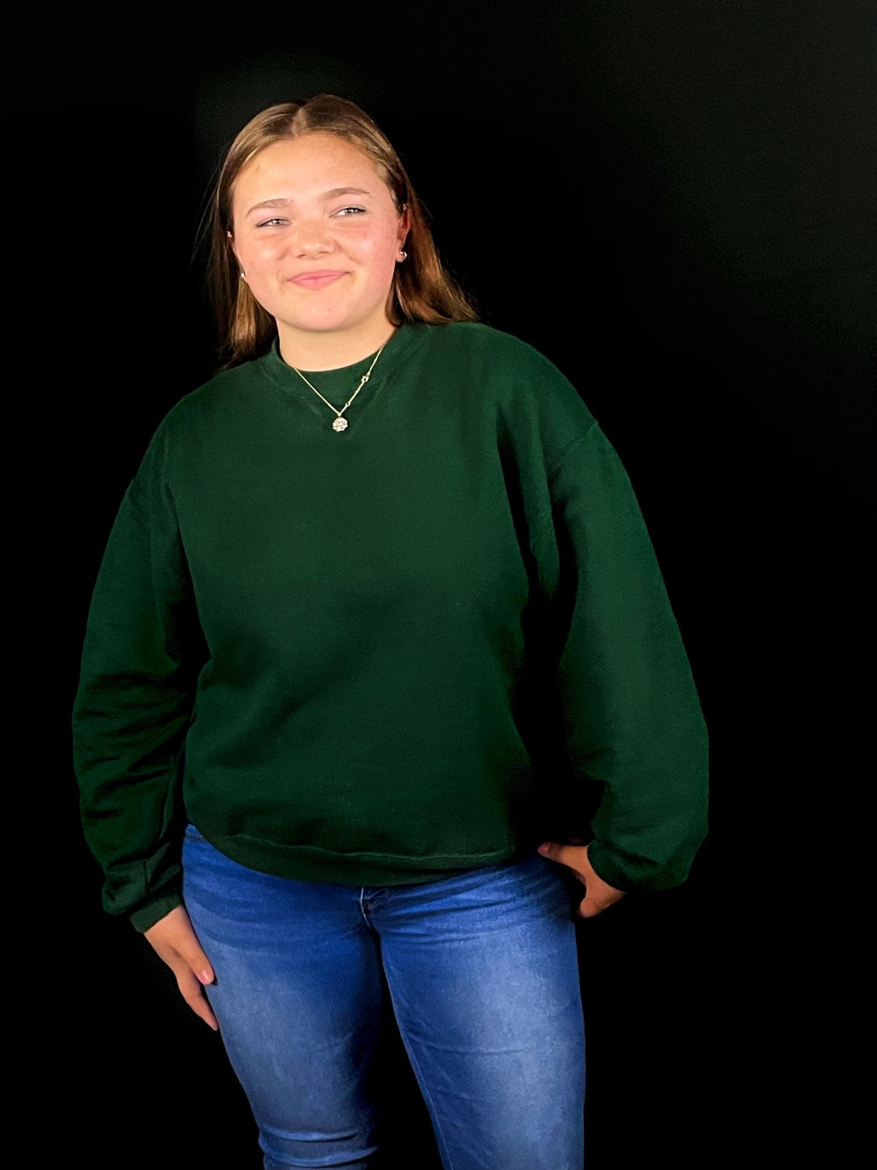
Studio Portrait
I wanted the background to be plain to make Sarah stand out. I edited the picture to make Sarah’s complexion look brighter. Also, I took the picture far away to really capture the full presence of Sarah. I also think it is unique because of the way she is posing in the picture.
The Model Sarah

Slide 8
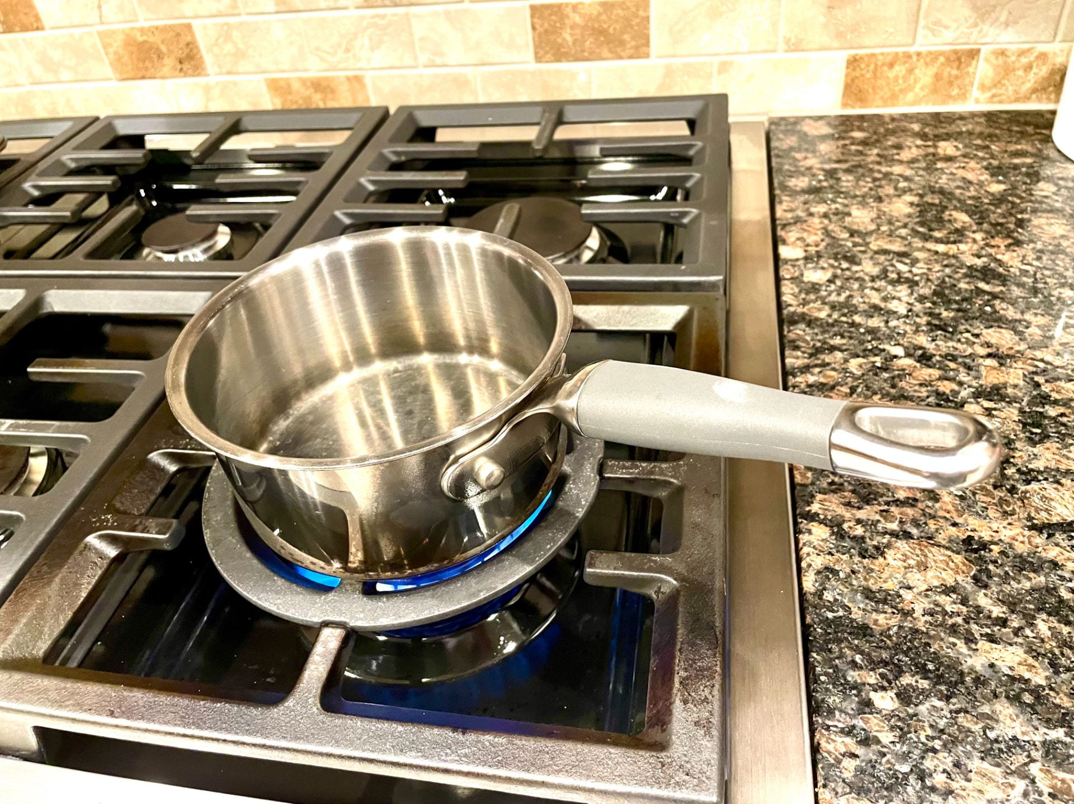
Conceptual Self Portrait
The goal of the photo was to capture something that represent who I am. The picture was taken far away to capture the whole pan. To make it seem more real, I added the flame under it. I chose to take this image because I absolutely love to cook. Ever since I was little, you would always see me in the kitchen helping my mom cook dinner. It has also inspired me to potentially own a restaurant in the future.
Cooking

Slide 9
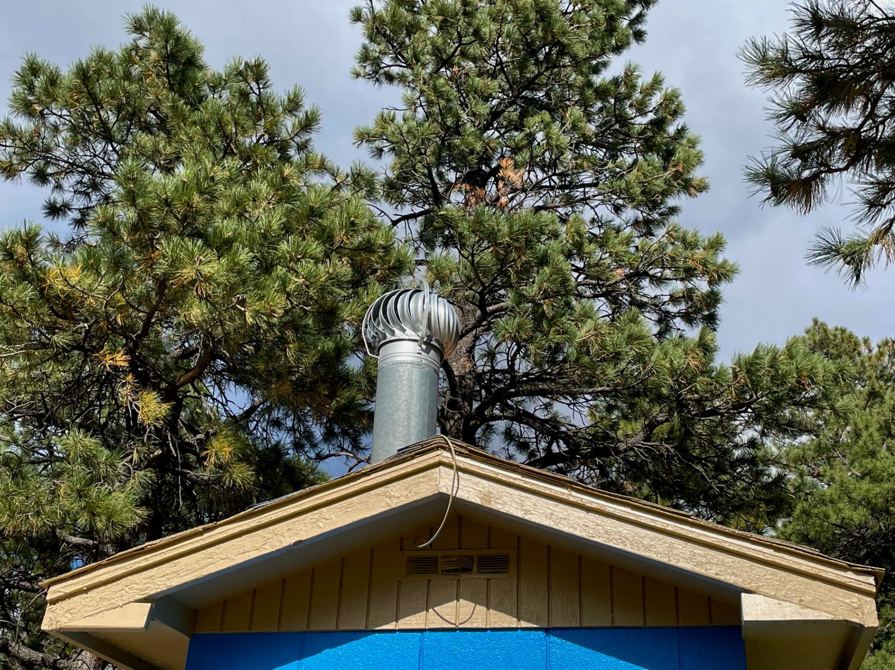
Triangles in Nature
The goal of the photo was trying to make you think outside of the box to try and think of where you could find triangles out in nature. I had to take this photo at a higher viewpoint, because was a roof of a building. Also, I made the trees in the background go a tad bit blurry to make the roof stand out more.
Raise it to the Rooftop

Slide 10
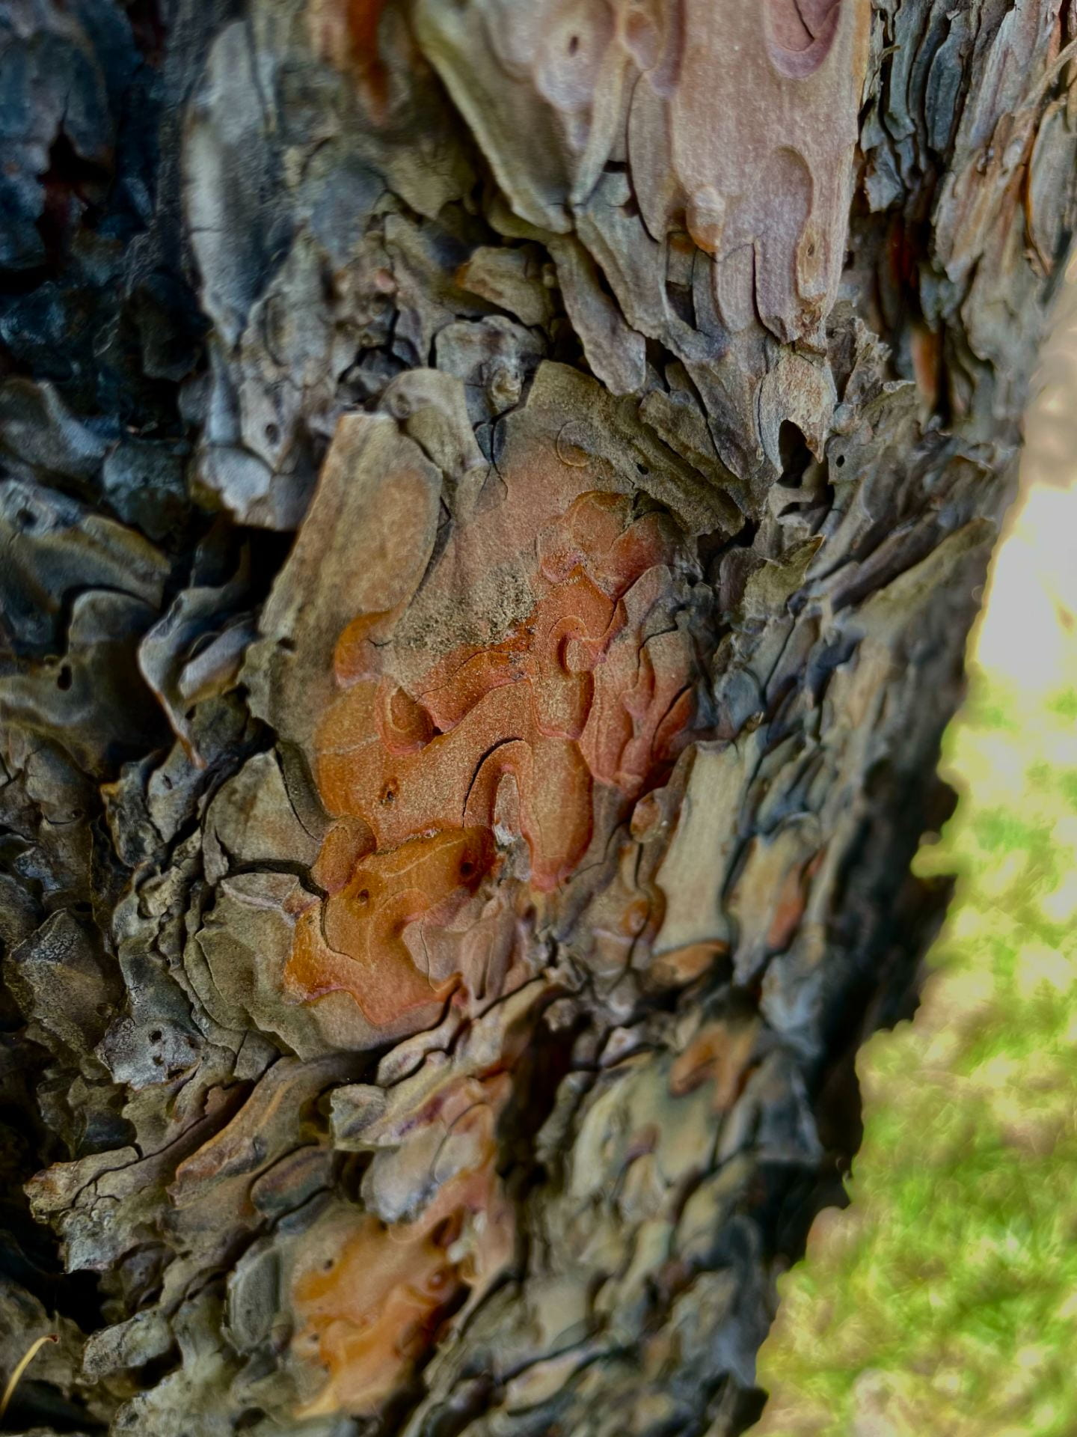
Up Close and Detail Landscape
The goal of this project was to find things in nature and take up close images of them rather than far landscape pictures. I think this image is unique because it almost doesn't even look like tree bark. I edited it to where it almost looks unreal. The blurriness in the back almost makes it look more vibrant and alive. Also, if you look closely it somewhat look like a fire in the middle. The bright orange is what makes it look like a fire compared to the dark browns and blacks in the picture.
Fire Tree

Slide 11
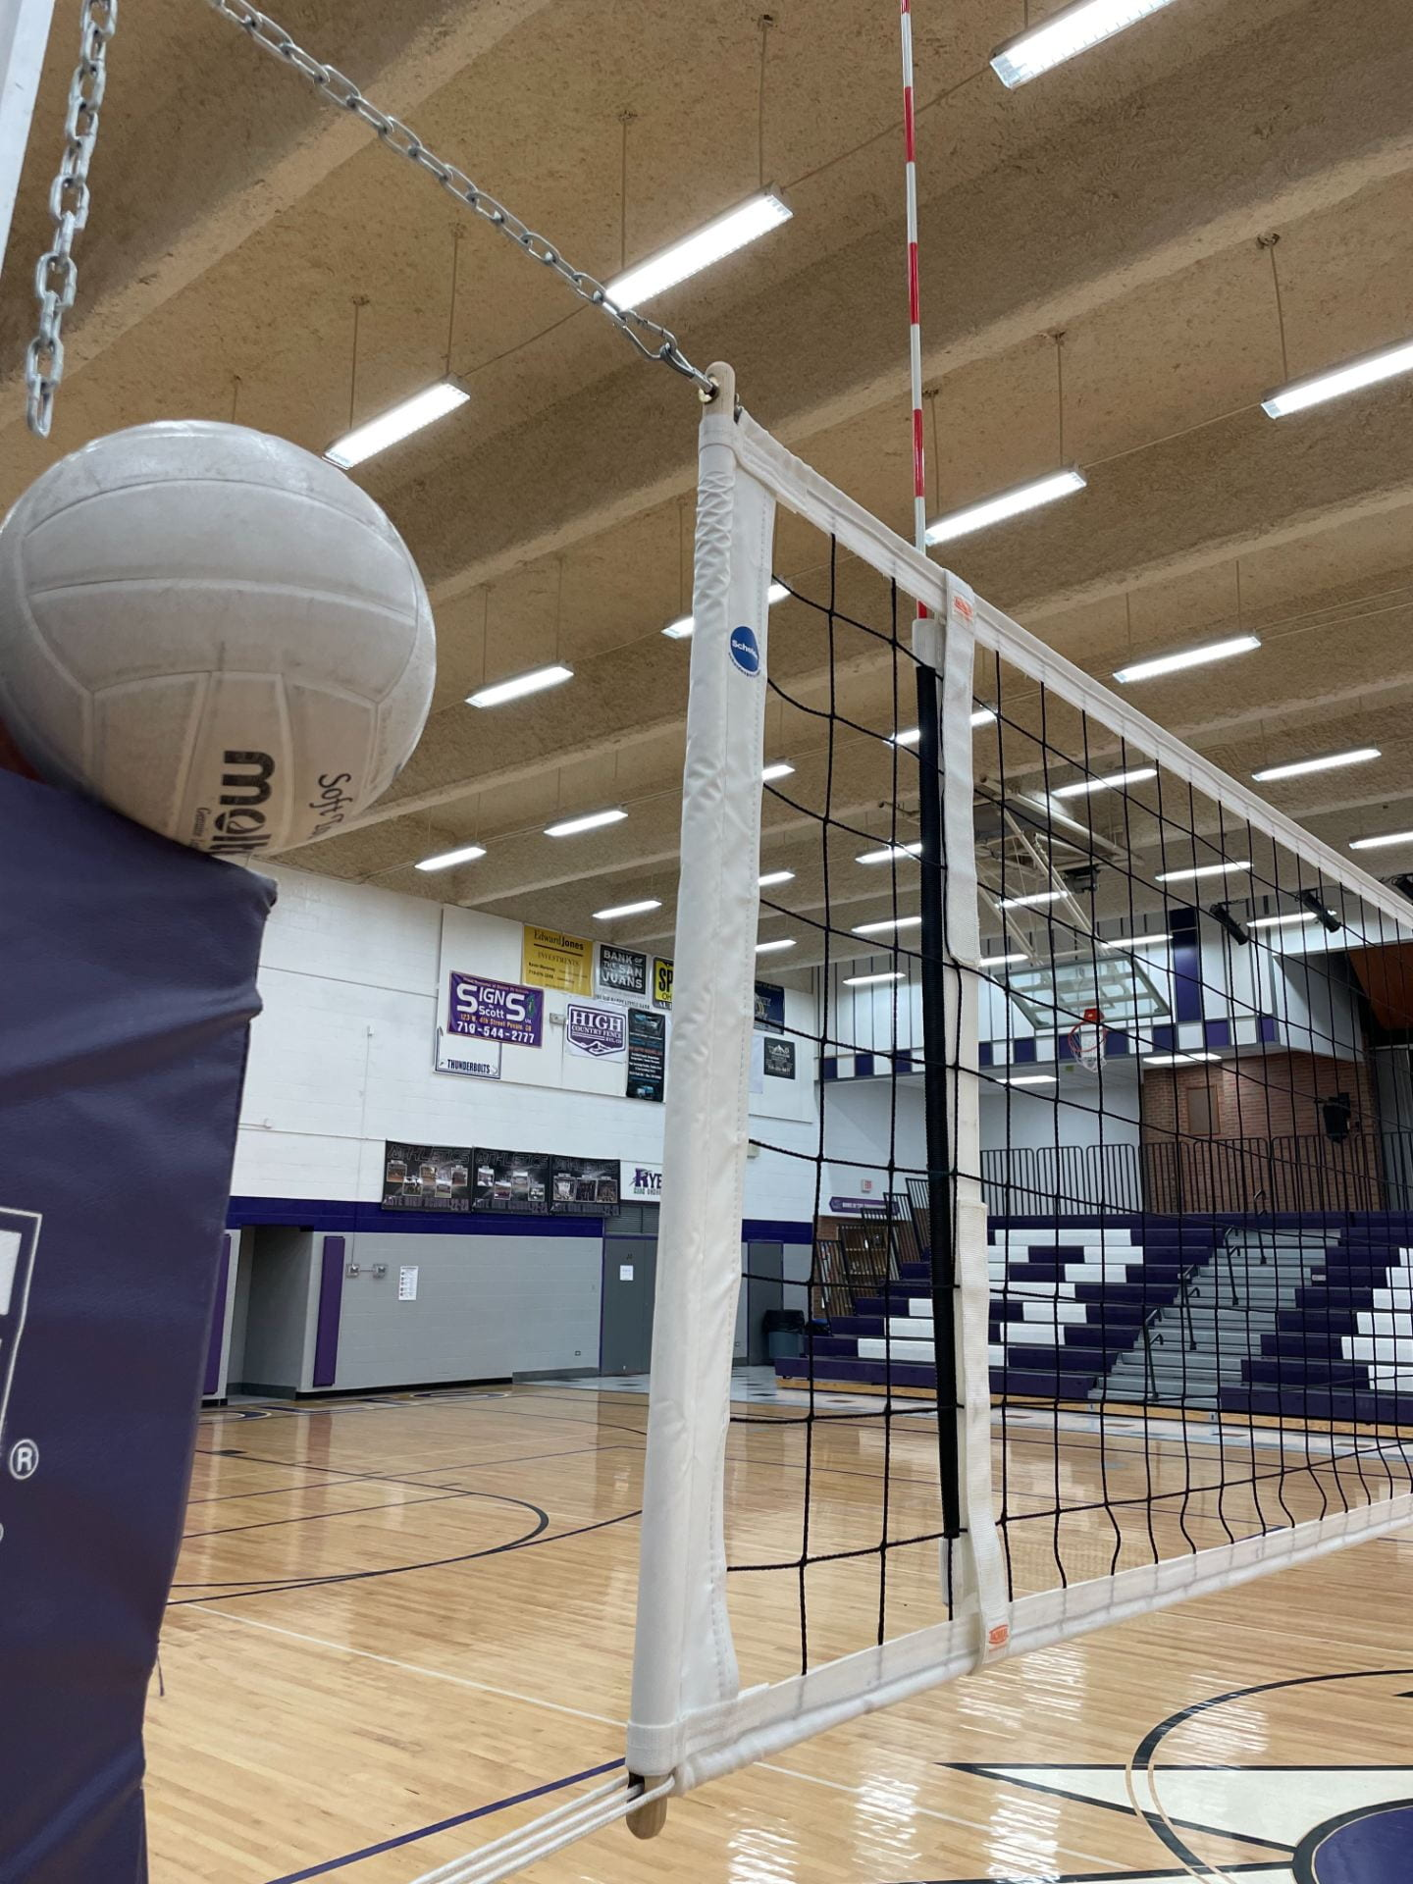
Conceptual Self Portrait
Volleyball
This photo I had to be creative to really capture the goal of showing who I am. I wanted to include the net but also make sure there was a volleyball in the picture. In the picture I was trying my best to capture most of the net, so I took the picture at somewhat of an angle. In some ways the picture is telling a story.

Slide 12
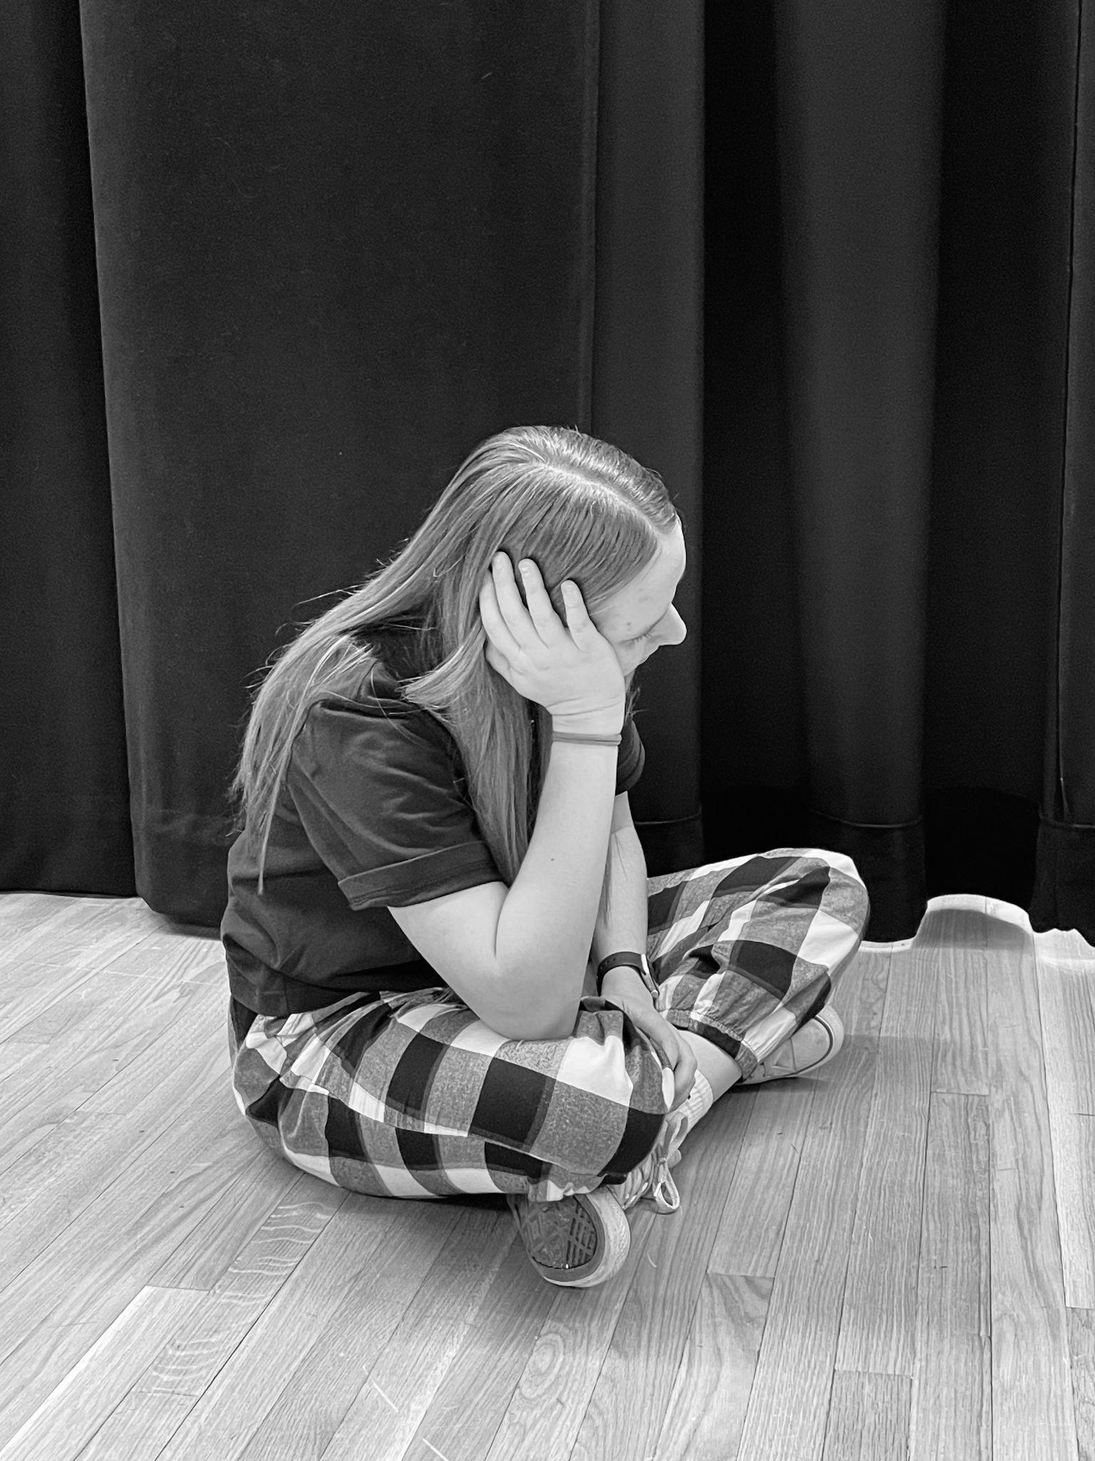
Documentary Photography Project
The goal of the project was to tell a story about something that is going on in your life. My project was about stress with a little bit of anxiety. Through this image I was trying to show how anxiety can really take a toll on your body. I made image black and white to get a more sad feeling. Also, I took the picture a medium and higher viewpoint.
Anxiety

Slide 13
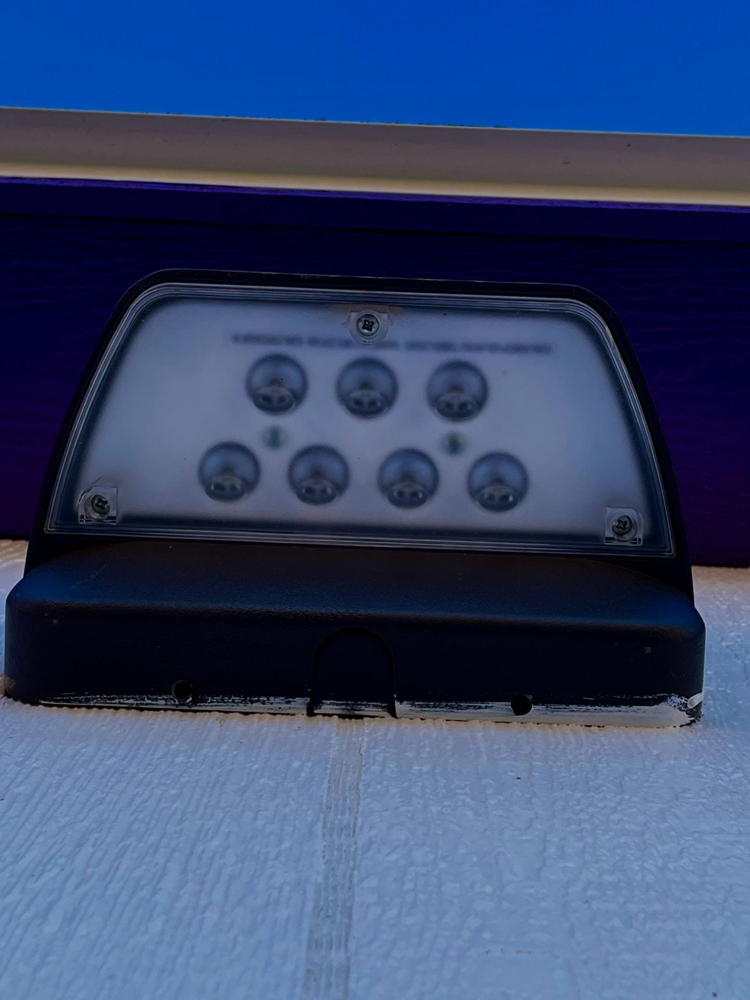
Different Point of View
The goal of this picture was to angle the phone at a certain angle to capture the bottom of a light. I had the phone at a horizontal angle. Then I made the colors seem darker. That was to mainly show the contrast of the light.
Light

Slide 14
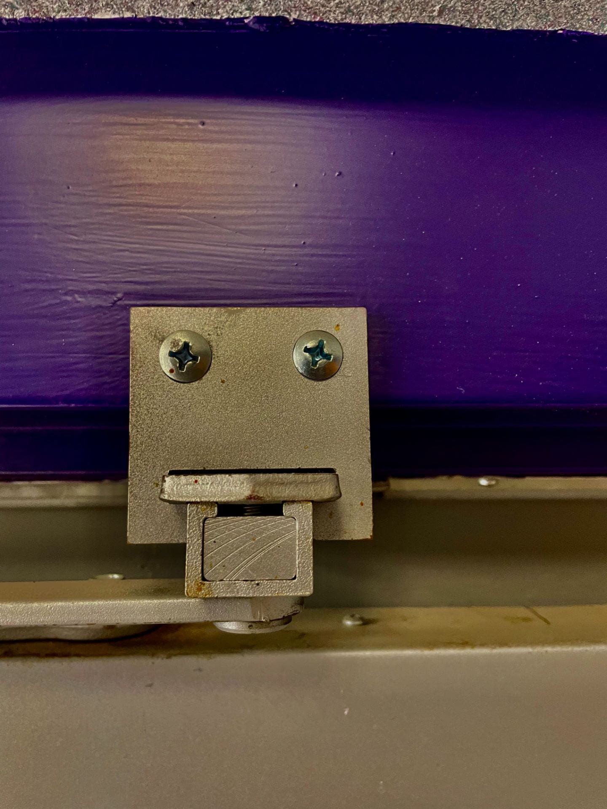
Hidden Faces
The goal of the assignment was to think about places in your everyday life where a hidden face might be. You had to get creative with it. This photo was part of a door hinge. So I had to take the photo from a high viewpoint. I made the background with purple pop a little more. Also made the details in the hidden face stand out a little more.
Steel Smile

Slide 15
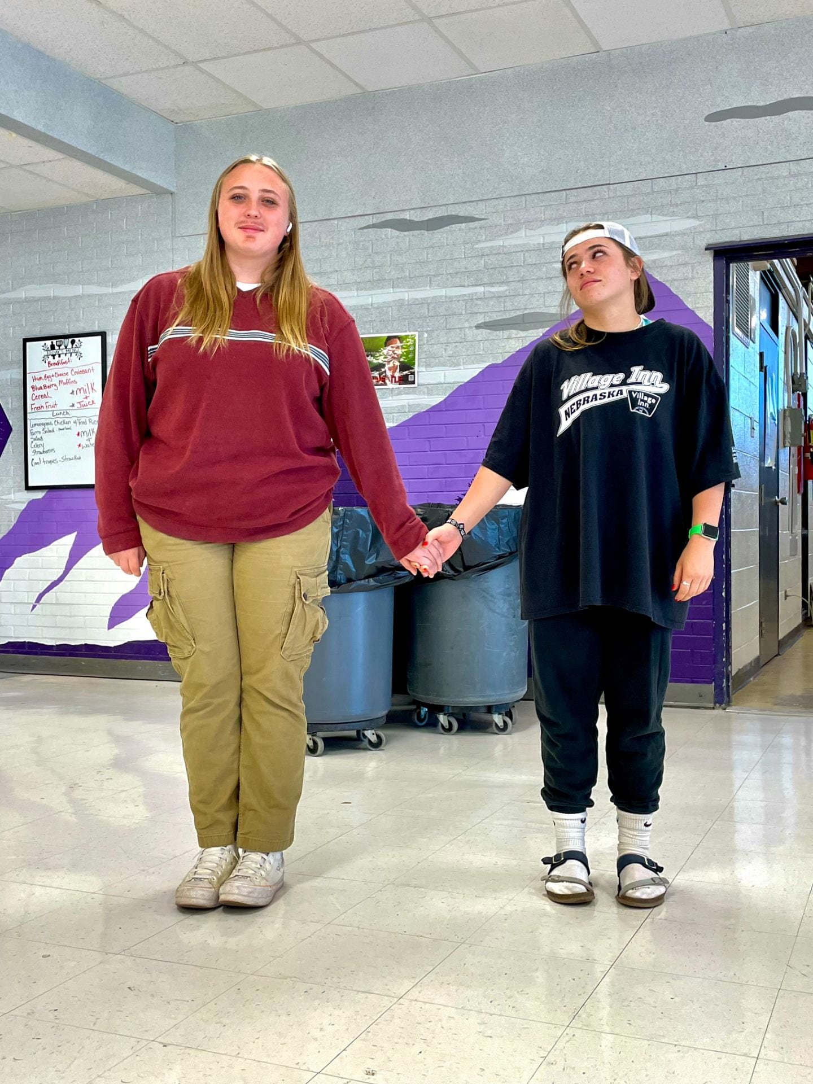
Homecoming Photos
Duo Day
Goal of the picture was to capture all the fun and exciting moments of homecoming week. Mazzy and Desire dressed up for the duo day spirit day. I took the picture from a far away angle to capture the whole outfit. I also made the picture brighter. Mainly to make it seem more vibrant.

Slide 16
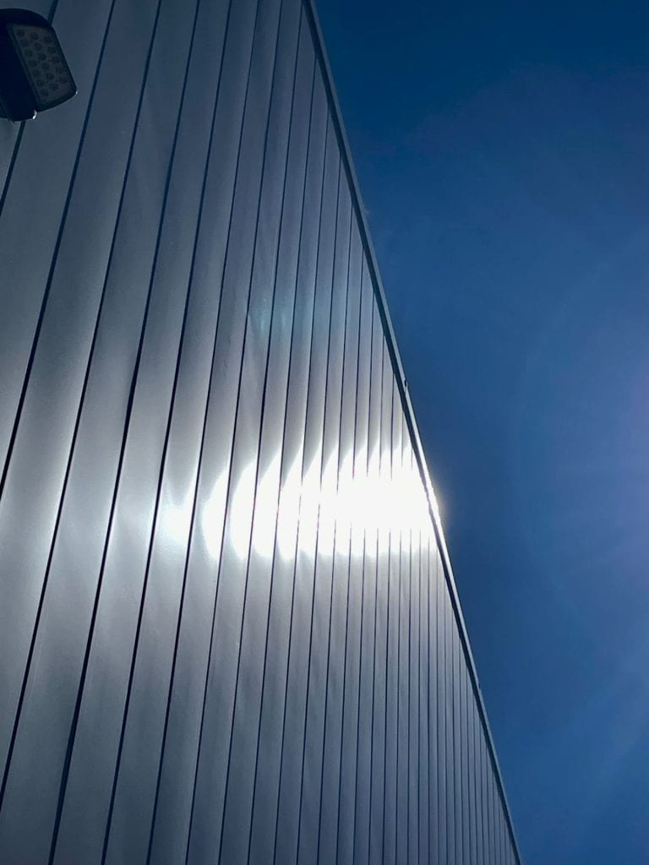
Lighting
Light Beam on Building
In this photo the goal was to capture the lighting from the sun on different objects. I wanted to take this picture to capture the sun beaming on the building. Since, the school is taller I had to angle my phone up. Then I had to take the picture at a high viewpoint. I made the colors on the building seem darker to contrast with the bright sun beam.

Slide 17
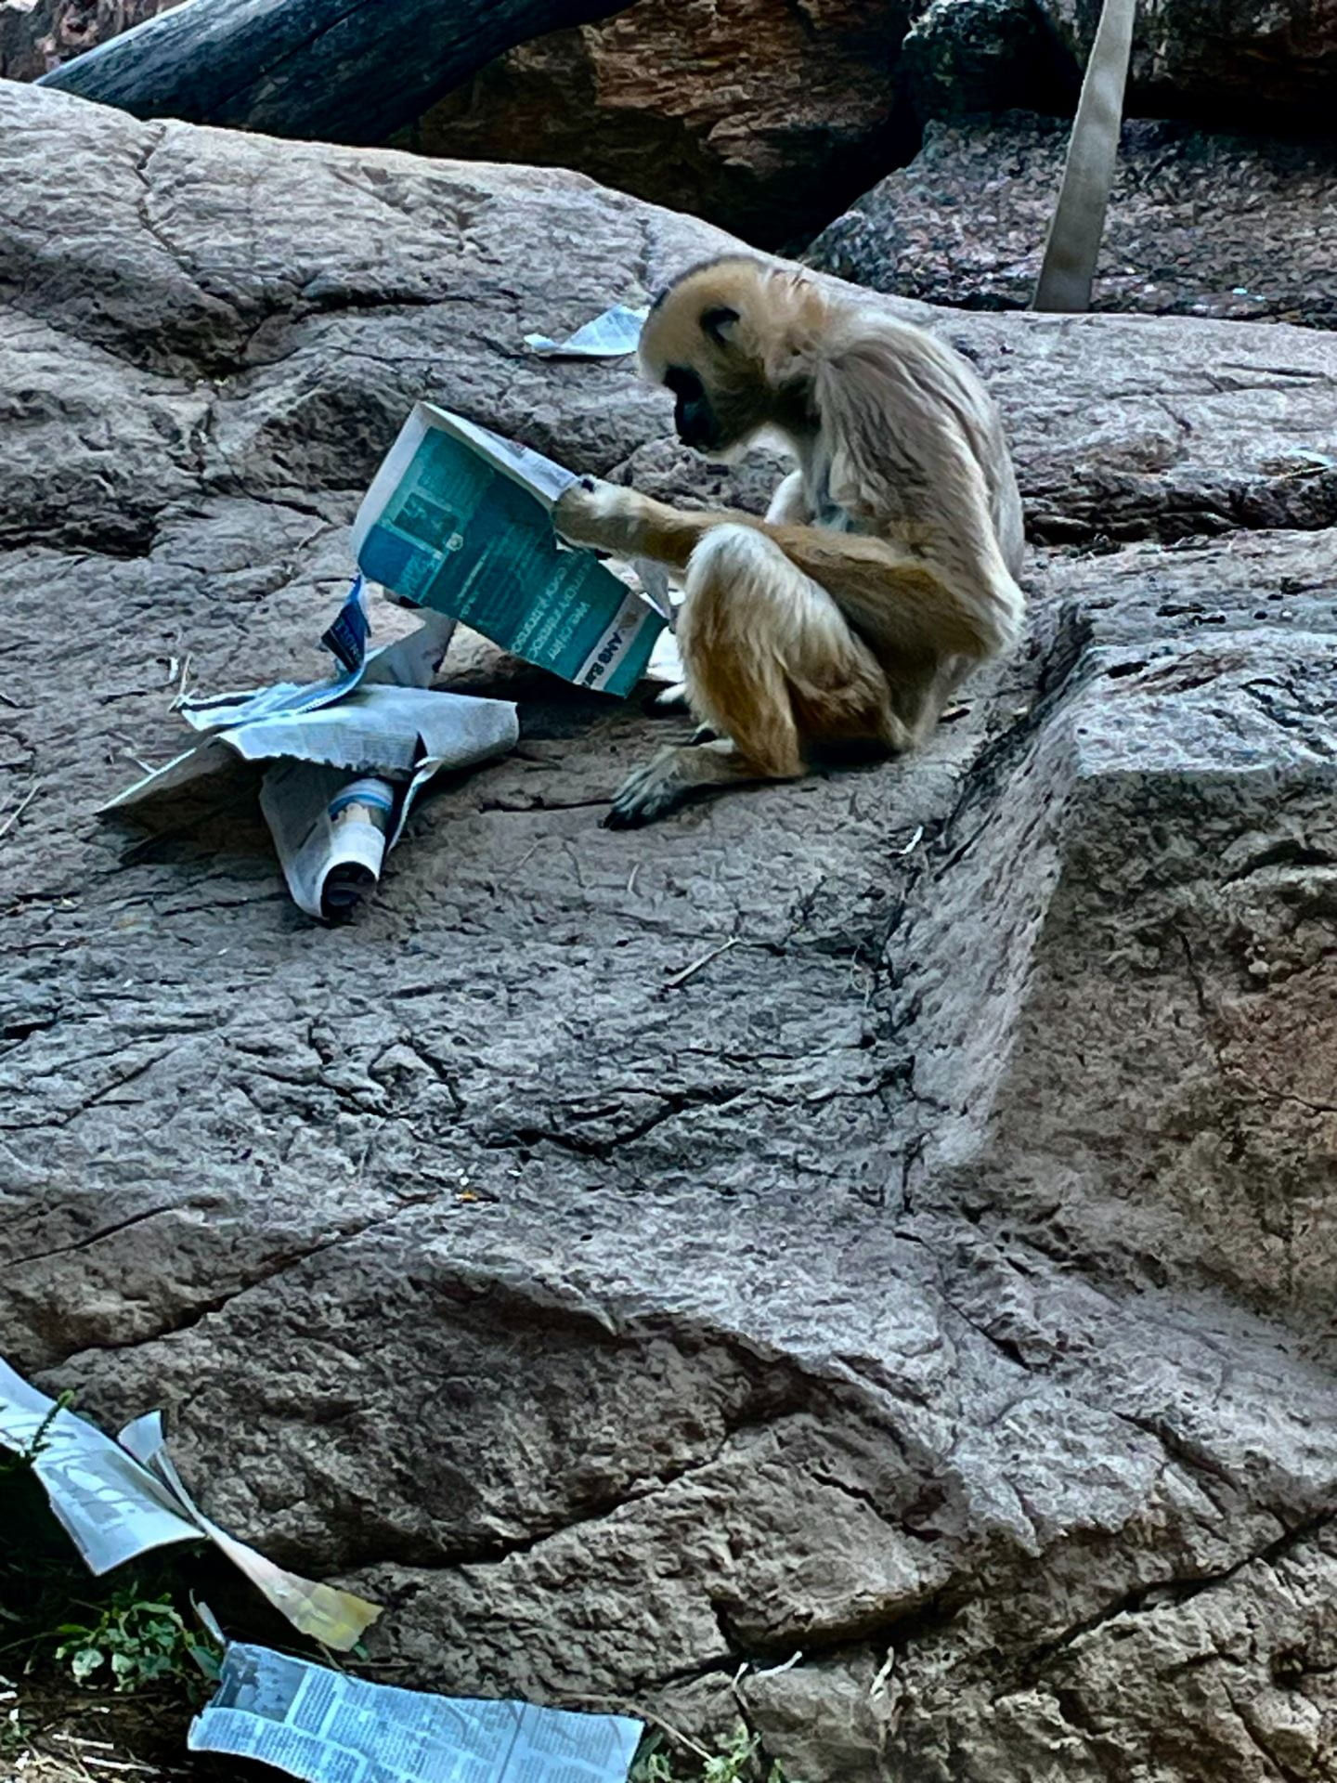
Zoo Photos
A Monkey Reading
The goal was to capture that animas at the zoo with the struggles of either fences or glass. You had to angle the camera just right not to get a reflection in glass. As well as make the lens seem like it is going through the fence, to just capture the animals. I thought this photo was very unique because it really looks like the animals is reading a magazine. Which is something that you don’t see everyday.

Slide 18
My Favorite Assignments
I honestly enjoyed every assignment in this class. Although if I had to pick a few it would be the zoo photos, hidden faces, and homecoming photos. It was fun taking photos at the zoo with all of my friends. Plus, it was nice to have a different scenery rather than the just the school. The hidden faces assignment was cool because it made you think outside the box. It was also just sort of funny seeing all the faces that you wouldn’t think would be there. Last, the homecoming photos were just really fun to take. I was capturing all kinds of memories. Also, each and every one of those helped me think about the different aspects and viewpoints that I should be taking the photo at.

Slide 19
How I have Progressed in Photography
In the beginning of the semester I didn’t really know a whole lot about photography. I didn’t realize how much goes in to taking a good quality picture. I think over time I got better at editing the picture. By mainly making them look more alive. Having the color in the pictures become more electrifying. Or to create a story, I would maybe edit the picture in black and white. My viewpoints got a little better over time.

